Slide 1
Team 11 Suspicious Package Training Aid
Jeremiah Franke
Devin Lorenzen
Edward Sayers
Seth Ward

Slide 2
Problem Overview
A request for a training aid from the Oregon Zoo.
Specific protocols need to be followed in the event of the discovery of an unattended package.
The unattended package needs to be isolated and unmoved.
Radio communication cannot be used in proximity of the device.

Slide 3
Marketing Requirements
Must:
Be able to detect when a two-way radio is transmitting at a frequency of 410-470 MHz in proximity of the device.
Be able to detect if the device is moved or agitated.
Be able to notify the end user if either of the previous two events has occurred.
Be portable and easily concealed.
Last the duration of a training period.
Should:
Notify the user of which event specifically caused a training fault.
May:
Wireless activation of the device.
Allow users to modify sensitivity of RF detection.

Slide 4
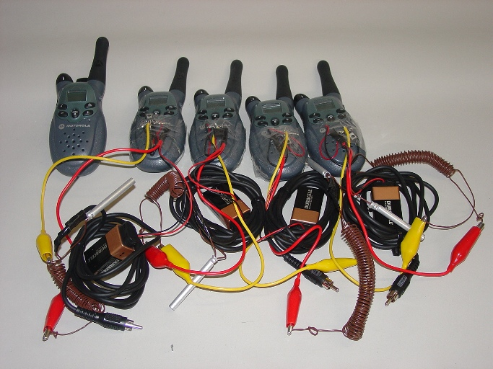
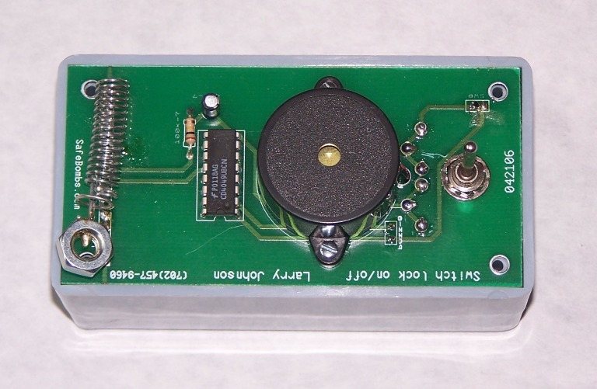
Current Market Solutions
There are several available alternatives on the market
These solutions are prohibitively expensive and single purposed
None of the solutions offered met the marketing requirements in a single device.

Slide 5
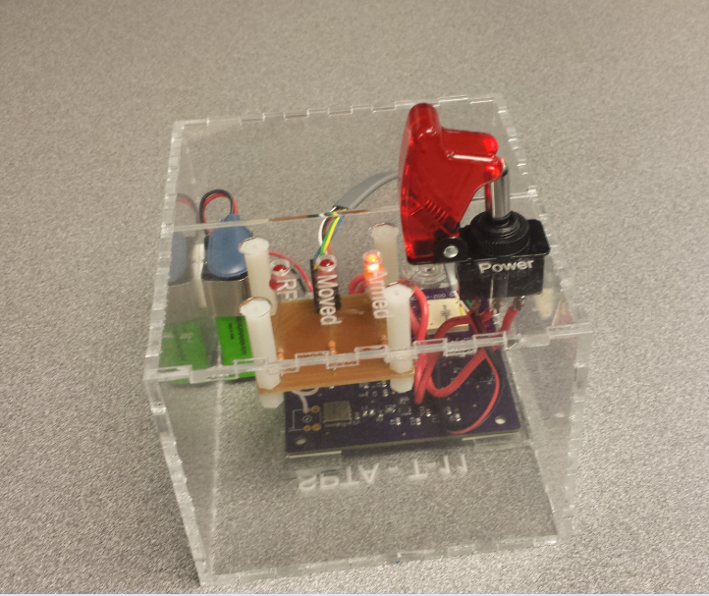
Project Implementation
Vibration sensor
RF detector
Microcontroller
Auditory and visual indicators

Slide 6
Level 1 Block Diagram

Slide 7
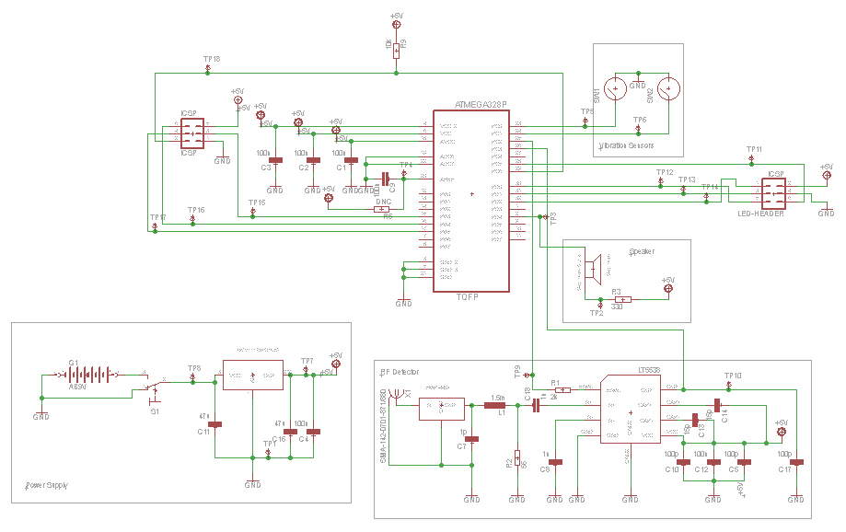
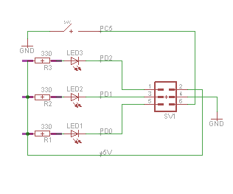
Schematics

Slide 8
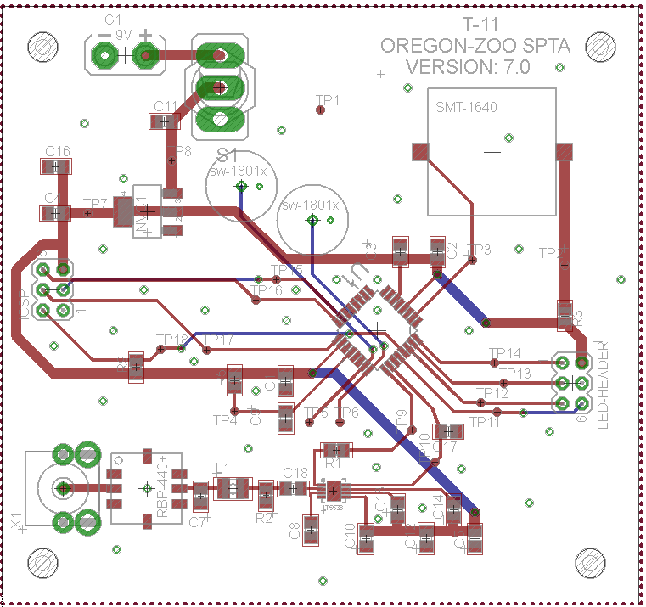
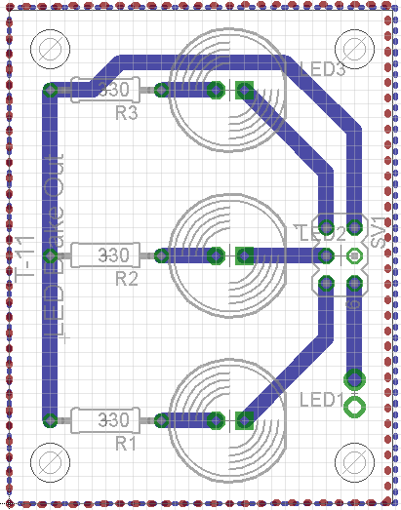
Board Layout

Slide 9
Source Code Overview

Slide 10
Tools Used
Hardware
Software
LPKF Board Router
Reflow Oven
Laser Cutter
Soldering Iron
AVR Dragon
Atmel Studio 5
Eagle Cad
InkScape

Slide 11
Testing
Power Regulation
RF Detection
Movement Detection
LED Indicators
Power Switch
Processor
Buzzer

Slide 12
Statistics
68% surface mount components
Current draw while armed: 56.5 mA
Current draw while triggered: 37 mA
Estimated battery life of 10 hours
175 lines of code

Slide 13
Contributions
Task | Primary contributors
Board Schematic | Devin, Edward
Board Layout | Devin
Code | Edward
Part Acquisition | Jeremiah, Seth
GitHub and Wiki Management | Seth
Documentation | All
Assembly | All
Testing | Jeremiah, Edward

Slide 14
What we would do differently
Results
All four boards were fully assembled and function tested
RF section performed as expected
Vibration section worked adequately
Explore other options for the vibration sensor
Source a louder buzzer
Remote activation switch
Opaque and water resistant packaging
Onboard RF sensitivity calibration
Source or design a less expensive band pass filter

Slide 15
Lessons Learned
How to use the tools in the EPL lab
Group Project Design
Teamwork
Compromise
Eagle Cad
Revision Control

